Slide 1
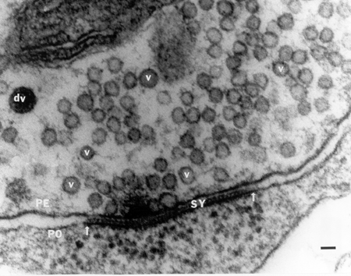

Slide 2
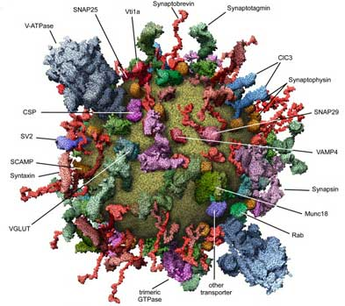
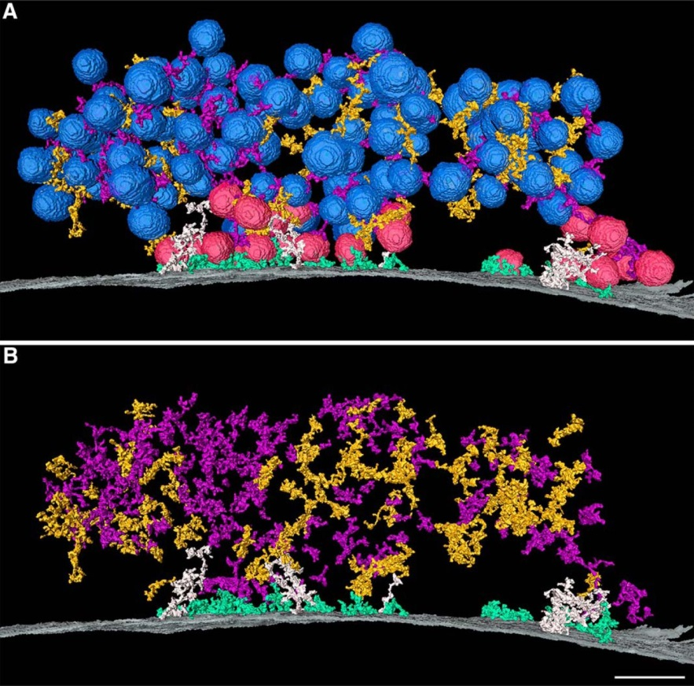
Sudhof, T.C. (2004), Annu. Rev. Neurosci. 27, 509–547
Andy A. Cole, Xiaobing Chen and Thomas S. Reese
Journal of Neuroscience. 2016, 36 (11) 3222-3230;

Slide 3
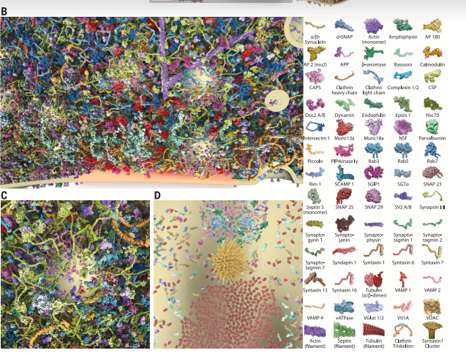

Slide 4
